Slide 1
COLLEGE OF POPULATION STUDIES · CHULALONGKORN UNIVERSITY
Population Growth and Sources of Demographic Data
Session 2 · From Censuses to Digital Trace Data
Course 5140602 · Fundamental Demographic Analysis (Revised 2026 Syllabus)
Asst. Prof. Dr. Ruttiya Bhula-or
College of Population Studies, Chulalongkorn University
3-hour session

Slide 2

RECAP
From Session 1: The Toolkit We Bring Today
We defined demography and its two branches (formal demography and population studies)
We practiced counts, proportions, ratios, and rates — the building blocks of every indicator
We situated demography in a data landscape that spans official statistics and emerging digital sources
Today we ask: Population growth rate, where do all these numbers actually come from — and how much should we trust them?
Session 2 · Fundamental Demographic Analysis · College of Population Studies, Chulalongkorn University
2

Slide 3






LEARNING OBJECTIVES
By the End of This Session, You Will Be Able To…
Apply the balancing equation
Decompose population change into births, deaths, and migration
Compute growth & doubling time
Use exponential growth models
Compare official data sources
Evaluate censuses, CRVS, surveys, and registers on coverage and quality
Assess data quality
Detect age heaping using Whipple’s Index
Evaluate digital-trace data
Weigh strengths and biases of mobile, satellite, and social-media data
3

Slide 4





AGENDA
Today’s 3-Hour Structure
Recap, objectives & agenda
Block 1 — The balancing equation & growth-rate math
Block 2 — Official/traditional data sources & quality assessment
Break
Block 3 — Non-traditional & digital-trace data
Synthesis: triangulating data sources
Wrap-up, Q&A, practice exercises
4

Slide 5
BLOCK 1
The Balancing Equation & Growth-Rate Math
Population change decomposed; exponential growth; doubling time — the arithmetic every demographer must be fluent in.
Notes:
Join Zoom Meetinghttps://chula.zoom.us/j/97199430458?pwd=MqWcROszPkaixVZDlTjBE99X9ettaY.1Meeting ID: 971 9943 0458Password: 715492

Slide 6





BLOCK 1 · COMPONENTS
Four Components, One Accounting Identity
Births (B)
Deaths (D)
In-migration (IM)
Out-migration (OM)
Additions from fertility — measured via CRVS or surveys
Losses from mortality — measured via CRVS or verbal autopsy
Additions from people moving into the area
Losses from people moving out of the area
7

Slide 7

BLOCK 1 · FOUNDATIONS
The Demographic Balancing Equation
P₂ = P₁ + B − D + IM − OM
Fill the missing numbers
Scenario | (P_1) | Births (B) | Deaths (D) | In-migration (IM) | Out-migration (OM) | (P_2)
1. Low fertility, migration-led growth | 500,000 | 4,500 | 5,000 | 12,000 | 3,000
2. Population decline | 800,000 | 6,000 | 9,500 |  | 7,000 | 793,500
3. Natural increase but net out-migration | 2,000,000 |  | 20,000 | 8,000 | 25,000 | 1,995,000
P₁, P₂ = population at times 1 and 2
B = births, D = deaths (natural increase = B − D)
IM = in-migration, OM = out-migration (net migration = IM − OM)
This single identity underlies every population estimate, projection, and intercensal check you will ever perform
6
Notes:
508,500
4,000
32,000

Slide 8


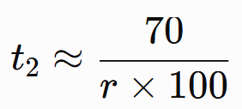
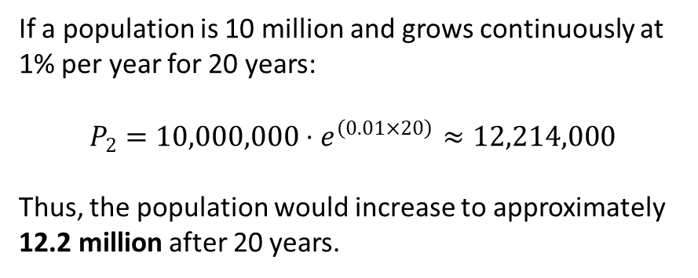
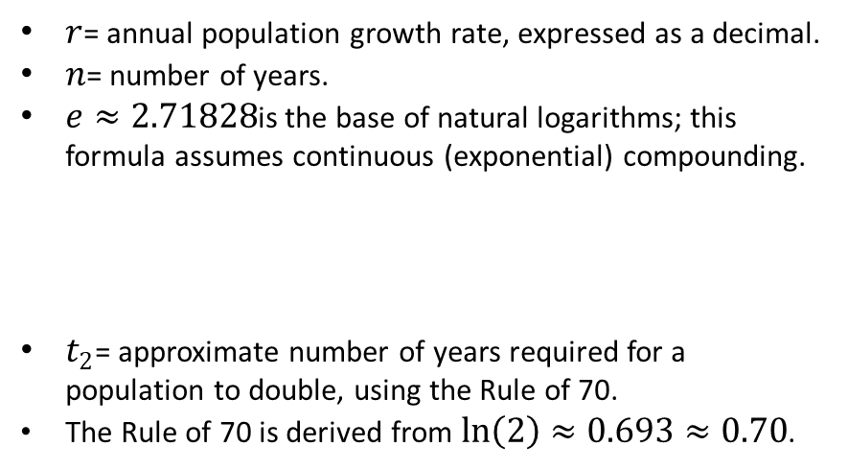
BLOCK 1 · GROWTH MODELS
Exponential Growth & the Rule of 70
A discrete-growth alternative is also commonly used
$r$= annual population growth rate, expressed as a decimal.
$n$= number of years.
$e≈2.71828$is the base of natural logarithms; this formula assumes continuous (exponential) compounding.
$t_{2}$= approximate number of years required for a population to double, using the Rule of 70.
The Rule of 70 is derived from $ln⁡\left(2\right)≈0.693≈0.70$.
If a population is 10 million and grows continuously at 1% per year for 20 years:
$$P_{2}=10,000,000⋅e^{\left(0.01×20\right)}≈12,214,000$$
Thus, the population would increase to approximately 12.2 million after 20 years.
8

Slide 9

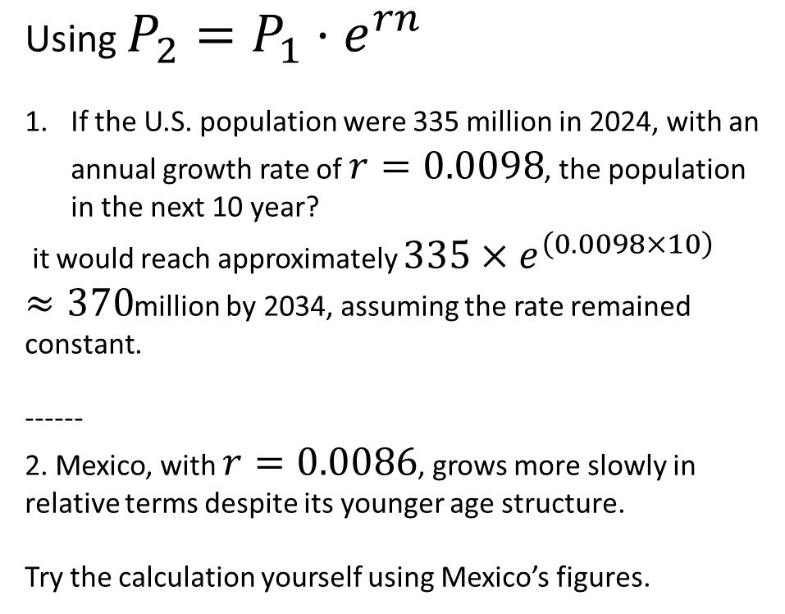
BLOCK 1 · WORKED EXAMPLE
Comparing Real Growth Rates: US vs. Mexico, 2024
Using $P_{2}=P_{1}⋅e^{rn}$
If the U.S. population were 335 million in 2024, with an annual growth rate of $r=0.0098$, the population in the next 10 year?
it would reach approximately $335×e^{\left(0.0098×10\right)}≈370$million by 2034, assuming the rate remained constant.
------
2. Mexico, with $r=0.0086$, grows more slowly in relative terms despite its younger age structure.
Try the calculation yourself using Mexico’s figures.
Source: World Bank. (2025). Population growth (annual %) — United States, Mexico [Data set]. World Bank Open Data. https://data.worldbank.org/indicator/SP.POP.GROW
9

Slide 10

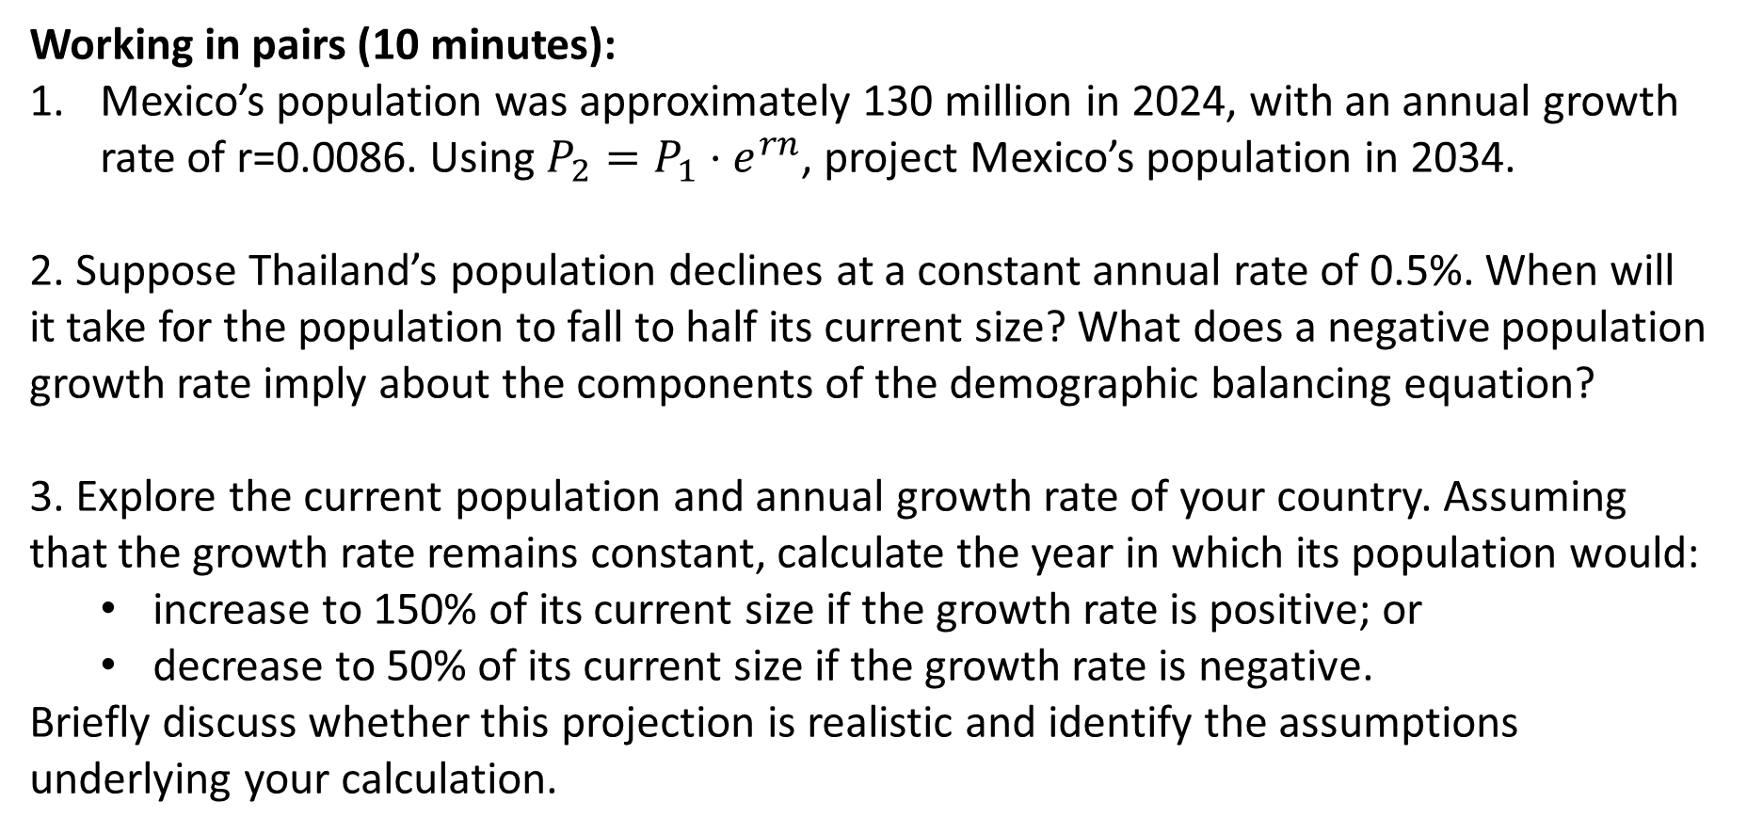
IN-CLASS EXERCISE
Your Turn: Growth Rate & Doubling Time
Working in pairs (10 minutes):
Mexico’s population was approximately 130 million in 2024, with an annual growth rate of r=0.0086. Using $P_{2}=P_{1}⋅e^{rn}$, project Mexico’s population in 2034.
2. Suppose Thailand’s population declines at a constant annual rate of 0.5%. When will it take for the population to fall to half its current size? What does a negative population growth rate imply about the components of the demographic balancing equation?
3. Explore the current population and annual growth rate of your country. Assuming that the growth rate remains constant, calculate the year in which its population would:
  increase to 150% of its current size if the growth rate is positive; or
  decrease to 50% of its current size if the growth rate is negative.
Briefly discuss whether this projection is realistic and identify the assumptions underlying your calculation.
11
Notes:
P2​=P1​ern P2​=130e(0.0086)(10)=130e0.086≈130(1.0898)≈141.7 million
If Thailand’s annual population growth rate is changed to −0.5%, then r=−0.005:
0.5P1​=P1​e−0.005n n=−0.005ln(0.5)​≈138.6 years

Slide 11
BLOCK 2
Official & Traditional Data Sources
The four pillars of official demographic statistics — and how to assess their completeness and quality.

Slide 12




BLOCK 2 · THE FOUR PILLARS
Official Sources of Demographic Data
Census
Civil registration & vital statistics
CRVS
Sample surveys
Population registers
Complete enumeration of a population at a point in time, typically every 5–10 years
Civil registration & vital statistics — continuous recording of births, deaths, marriages
Household surveys (e.g., DHS, labour-force surveys) collecting detailed data from a sample
Continuously updated administrative records of every resident, common in Nordic countries
13

Slide 13

Population census
Egyptologists estimate that a large-scale census was taken around 2600 BCE (before Common Era) under the reign of Sneferu (Wilkinson, 2000).
In the 1800s, the practice of taking population censuses spread through Western countries.
After a post–World War II phenomenon – population census has been promoted by the UN.
Source: Jennifer H. Lundquist, Douglas L. Anderton, and Barbara Yaukey (2015) DEMOGRAPHY

Slide 14
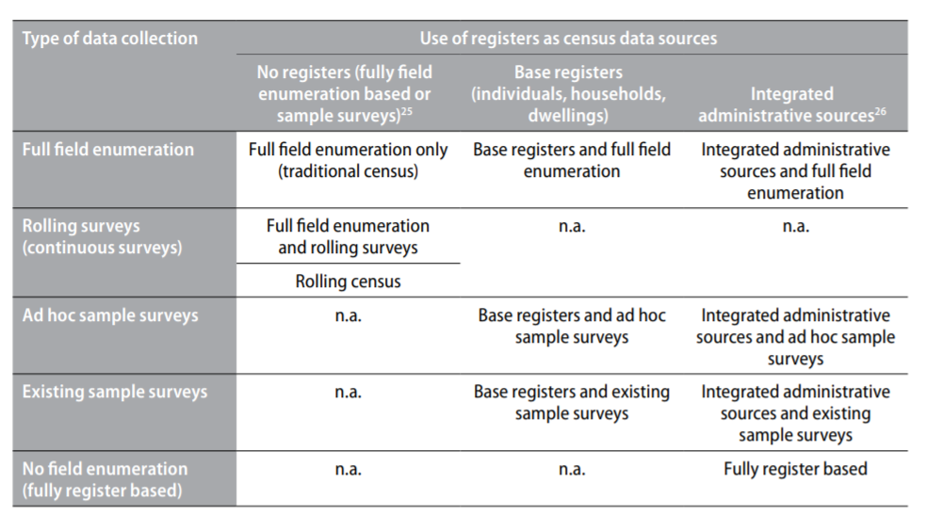
Source: https://unstats.un.org/unsd/demographic-social/Standards-and-Methods/files/Principles_and_Recommendations/Population-and-Housing-Censuses/Series_M67rev3-E.pdf

Slide 15
Basic features of a census
Individual enumeration;
The term “census” implies that each individual and each set of living quarters is enumerated separately and that the characteristics thereof are separately recorded.
2. Universality within a defined territory;
Everybody in the specified territory should be similarly counted and described.
3. Simultaneity;
Each person and each set of living quarters should be enumerated as of the same well defined point in time and the data collected should refer to a well-defined reference period.
4. Defined periodicity;
Periodic; Censuses should be taken at regular intervals so that comparable information is made available in a fixed sequence.
5. Capacity to produce small-area statistics;
The census should produce data on the number and characteristics of the population and housing units down to the lowest appropriate geographic level, compatible with national circumstance, and for small population groups, all the while protecting confidentiality of personal information on each individual.
Source: https://unstats.un.org/unsd/demographic-social/Standards-and-Methods/files/Principles_and_Recommendations/Population-and-Housing-Censuses/Series_M67rev3-E.pdf

Slide 16
BLOCK 2 · THE FOUR PILLARS
Official Sources of Demographic Data
Advantages
Provides the most comprehensive picture of the population and households.
Produces reliable statistics for small geographic areas and population subgroups.
Establishes benchmark population figures for national and local planning.
Provides sampling frames and population weights for household surveys.
Supports the allocation of public resources and political representation.
Enables comparisons across areas and, when definitions are consistent, over time.
Limitations
Expensive and operationally complex to conduct.
Usually conducted only every 5–10 years, so results may become outdated.
Requires considerable time for data processing, analysis, and publication.
May undercount hard-to-reach populations, including migrants, homeless people, and residents of remote areas.
Collects less detailed information than specialised sample surveys.
Results may be affected by non-response, reporting errors, political sensitivities, or inconsistent definitions.
Census
Complete enumeration of a population at a point in time, typically every 5–10 years

Slide 17
BLOCK 2 · THE FOUR PILLARS
Official Sources of Demographic Data
Modern census
It specifies the geographic boundaries of the area to be covered.
The government decides which traits it needs to know about for each of its people and settles upon a questionnaire.
Simultaneously, within all of the subareas, the government sends out the assigned enumerator to visit households and to list all of the individuals in each household.
The government compiles the information from the subareas, tabulating numbers of people by subarea (distribution) and by category of individual trait (composition)
The government reports the findings to the sponsoring citizenry.
Source: https://unstats.un.org/unsd/demographic-social/Standards-and-Methods/files/Principles_and_Recommendations/Population-and-Housing-Censuses/Series_M67rev3-E.pdf

Slide 18
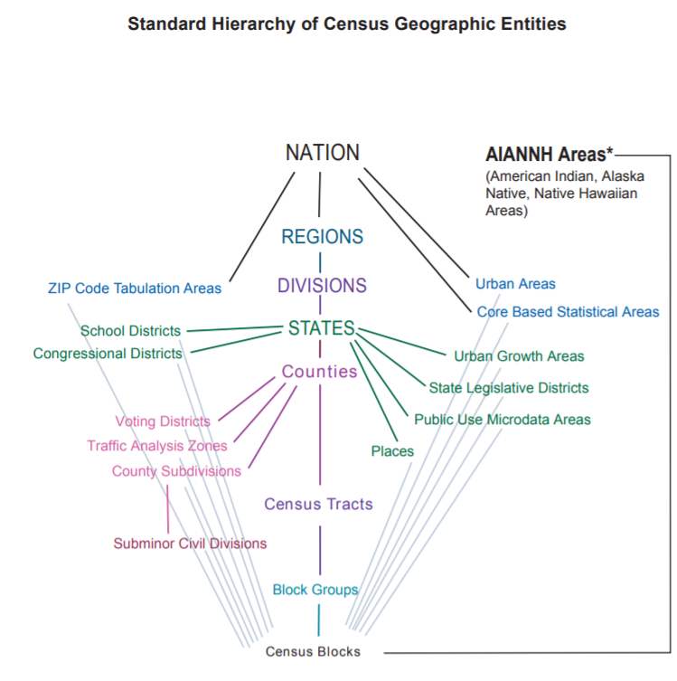
Standard Hierarchy of Geographic Entities for the 2010 Decennial Census
Source: https://www2.census.gov/geo/pdfs/reference/geodiagram.pdf

Slide 19
What topics to be included?
Political side
Technical side
The priority of national over international needs in determining census content e.g.
Hearings and debates dealing with demographic priorities
Rights to privacy
Complete and comparable.
Nations can enhance international comparability by taking censuses in standard years
Let’s take a look at the Thai census
https://unstats.un.org/unsd/demographic/sources/census/quest/THA2010en.pdf
http://www.nso.go.th/sites/2014en/Pages/popeng/2010/mainpop.aspx
Source: Jennifer H. Lundquist, Douglas L. Anderton, and Barbara Yaukey (2015) DEMOGRAPHY

Slide 20

EXAMPLE 1
Thailand’s 2025 Census Goes Digital-First
Thailand’s National Statistical Office ran the 2025 Population and Housing Census under a "Digital First Approach," directing respondents to self-report via a web application and government portal before enumerator follow-up
This is a major shift from the 2020 census round, when online/mailed pilot response rates were only about 5% and 4% respectively
Censuses are costly (they attempt to count everyone) and infrequent — but they remain the gold-standard sampling frame that surveys and small-area estimates are built on
Source: United Nations ESCAP (2024). Thailand Population and Housing Census 2025 [Conference presentation]. Asia-Pacific Stats Café Series. https://crvs.unescap.org/system/files/sites/default/files/Thailand_presentation.pdf
14

Slide 21

EXAMPLE 2
Thailand’s Near-Complete Civil Registration
By 2024, Thailand reached essentially 100% registration of births occurring within its territory in that year, as part of the Asia-Pacific CRVS Decade (2015–2024) coordinated by UN ESCAP
Challenges remain: a high share of deaths occur outside health facilities, requiring special programs to improve medically certified cause-of-death coding
CRVS data — unlike a census — are continuous, giving up-to-date annual counts of births and deaths, the numerator for CBR, CDR, and related rates
Source: United Nations ESCAP (2024/2025). Get Every One in the Picture: Thailand country profile. https://getinthepicture.org/country/thailand
15

Slide 22
Checkpoint
Find Population and Housing Census from United Nations Statistics Division - Demographic and Social Statistics
https://unstats.un.org/unsd/demographic-social/census/document-resources/
Select two Population and Housing Census questionnaires from two different countries, and provide the criteria for your selection.
You will have 15 minutes to compare the questionnaires between the two countries. Afterward, share 2-3 observations related to the content of the questionnaires. Each group will have 3 minutes to report back.

Slide 23
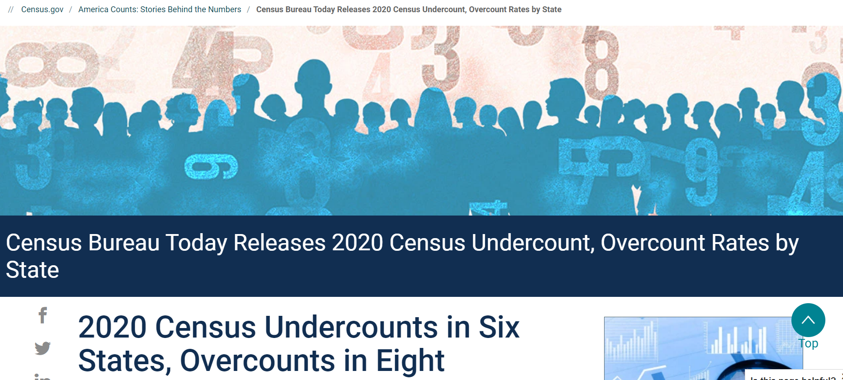
How to cope with discrepancies?
For example
https://www.census.gov/newsroom/press-releases/2022/2020-census-estimates-of-undercount-and-overcount.html
https://www.census.gov/library/stories/2022/05/2020-census-undercount-overcount-rates-by-state.html#:~:text=If%20an%20estimated%20net%20coverage,error%20or%20more%20than%20once.

Slide 24
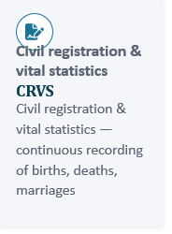
BLOCK 2 · THE FOUR PILLARS
Official Sources of Demographic Data
Advantages
Continuously records vital events, including births, deaths, marriages, divorces, and sometimes causes of death.
Produces more timely demographic information than a periodic census.
Provides legal identity and documentation needed to access rights and public services.
Supports the calculation of fertility, mortality, life expectancy, and cause-of-death indicators.
Can generate statistics for small geographic areas and monitor changes over time.
Covers the entire population in principle rather than only a sample.
Limitations
Registration may be incomplete, particularly in remote areas and among migrants or marginalised populations.
Some events may be registered late, inaccurately, or more than once.
Cause-of-death information may be missing or incorrectly classified.
Data quality and coverage can vary substantially across regions and population groups.
Civil registration systems may be fragmented across different government agencies.
Privacy, confidentiality, and restricted data access may limit research use.

Slide 25

BLOCK 2 · MORE SOURCES
Sample Surveys and Population Registers
Sample Surveys
Population Registers
Collect rich, detailed data (fertility histories, health, income) from a representative sample, not everyone
Examples: Demographic and Health Surveys (DHS), Thailand’s Labour Force Survey (NSO)
Fast and flexible, but subject to sampling error and potential non-response bias
Continuously updated administrative databases covering every resident (e.g., Sweden’s Register of Total Population)
Enable register-based "censuses" without door-to-door enumeration
Require a unique personal ID system and strong inter-agency data-sharing — not feasible everywhere
16

Slide 26

EXAMPLE 3
Careja and Bevelander (2018) show how Danish and Swedish population registers — built on unique personal identity numbers — provide systematic, longitudinal, near-complete data on residents, including immigrants
Register-linked data let researchers follow the same individuals across health, tax, and migration records over decades, something few surveys can match
The tradeoff: registers are only as good as administrative coverage and timely updating, and this model depends on high public trust and legal infrastructure most countries do not yet have
Population Registers as a Data Source: Denmark & Sweden
Source: Careja, R., & Bevelander, P. (2018). Using population registers for migration and integration research: Examples from Denmark and Sweden. Comparative Migration Studies, 6, 19. https://doi.org/10.1186/s40878-018-0076-4
17

Slide 27

BLOCK 2 · COMPARISON
Strengths and Limitations at a Glance
Source | Key strength | Key limitation
Census | Universal coverage; small-area detail | Costly; infrequent (5–10 yr gaps)
CRVS | Continuous, real-time vital events | Completeness varies; cause-of-death quality issues
Sample surveys | Rich detail; flexible design | Sampling error; possible non-response bias
Population registers | Continuous, near-complete, linkable | Requires strong ID/legal infrastructure
18

Slide 28
IN-CLASS EXERCISE
Your Turn
Working in small groups, select one country and address the following questions:
What official demographic data sources are available in your country?
Identify examples of the population census, civil registration and vital statistics (CRVS), sample surveys, and population registers. For each source, provide the responsible institution, latest available year, frequency of data collection, population coverage, and an official link. If a source is unavailable, explain why.
How do these sources differ in purpose and data quality?
Compare their major indicators, geographic coverage, timeliness, completeness, accessibility, and possible sources of error or undercoverage. Which population groups are most likely to be omitted or inadequately represented?
How should the sources be combined?
Select one demographic issue—such as fertility, mortality, migration, ageing, or population growth—and explain which source would be most appropriate. Discuss how another source could be used to validate or complement the findings.

Slide 29

BLOCK 2 · DATA QUALITY
Why Assess Completeness and Quality?
Every data source can misstate ages, undercount hard-to-reach groups, or lag behind real events
Age misreporting is one of the most common and best-studied data-quality problems — respondents (or enumerators) round ages to preferred digits, especially 0 and 5
This "age heaping" distorts age-specific rates, life tables, and population pyramids if left uncorrected
The UN formalized a simple diagnostic — Whipple’s Index — in its 1955 Manual II, still used by statistical agencies today
Session 2 · Fundamental Demographic Analysis · College of Population Studies, Chulalongkorn University
19

Slide 30

BLOCK 2 · DATA QUALITY
Whipple’s Index: Detecting Age Heaping
WI = [5 × Σ P(25,30,…,60) /
Σ P(23…62)] × 100
Suppose a household survey of 10,000 people aged 23–62 reports:
• 2,300 people report ages ending in 0 or 5 (e.g., 25, 30, 35 … 60)
• Total surveyed aged 23–62 = 10,000
WI = (5 × 2,300 / 10,000) × 100 = 115
Interpretation: WI = 115 falls in the UN’s "fairly accurate" to "approximate" range — noticeable preference for ages ending in 0 or 5, warranting caution in single-year age analysis.
Numerator: sum of persons reporting ages ending in 0 or 5, from 25 to 60
Denominator: total persons aged 23–62 inclusive
WI = 100 → no age preference; WI = 500
→ everyone reports a age ending 0/5
UN benchmark: <105 "highly accurate", 105–109.9 "fairly accurate" … >175 "very rough" data
20

Slide 31

LET’S DISCUSS
Why Does Age Heaping Happen?
What individual-level factors (education, literacy, birth documentation) might drive age heaping in a household survey?
Why might age heaping be worse in older cohorts than younger ones in the same country?
How might a National Statistical Office correct age-specific rates once it detects heaping?
22

Slide 32
BLOCK
Non-Traditional & Digital-Trace Data
Mobile-phone records, satellite imagery, and social-media data as fast, high-resolution complements to official statistics — with real caveats.

Slide 33

BLOCK 3 · THE MOTIVATING GAP
Official Data Update Slowly — Digital Signals Update Fast
Illustrative update latency (years) for population information, by source type.
Censuses may be a decade old by the time of use; even annual CRVS/survey data lag real-time events such as displacement or rapid urban growth.
Digital-trace data can update daily — motivating its use as a complement, not a replacement, for official statistics.
25

Slide 34

BLOCK 3 · MOBILE DATA
Mobile-Phone Call Detail Records (CDRs)
CDRs are logs mobile operators generate for billing: which cell tower a call/text connected through, and when
Aggregated and anonymized, tower-level CDRs reveal where subscribers are, in near-real time, across an entire country
Because CDRs are collected passively for billing (not demographic) purposes, they can achieve national coverage at a fraction of a census’s cost
Key limitation: only captures mobile subscribers — coverage gaps for children, the very poor, and multiple-SIM users must be modeled or corrected
Session 2 · Fundamental Demographic Analysis · College of Population Studies, Chulalongkorn University
26

Slide 35

EXAMPLE 4
Dynamic Population Mapping From Mobile Data
Deville et al. (2014, PNAS) used mobile-operator call data in Portugal and France to produce dynamic, fine-grained maps of population distribution — including daily commuting patterns official censuses cannot capture
The method estimates population density by combining call-volume patterns with a "top-down" census-based prior, so it stays anchored to official totals while adding spatial and temporal detail
The authors explicitly note applicability to low-income countries where census data are "scarce, outdated, or unreliable" — precisely the settings where traditional data are weakest
Source: Deville, P., Linard, C., Martin, S., Gilbert, M., Stevens, F. R., Gaughan, A. E., Blondel, V. D., & Tatem, A. J. (2014). Dynamic population mapping using mobile phone data. PNAS, 111(45), 15888–15893. https://doi.org/10.1073/pnas.1408439111
27

Slide 36

BLOCK 3 · SATELLITE DATA
Satellite Imagery-Based Population Mapping
Satellite imagery detects built-up areas, night-lights, and settlement footprints at very high spatial resolution (down to ~100m grid cells)
WorldPop (University of Southampton) combines satellite/geospatial layers with census counts and, increasingly, mobile-phone data using machine-learning (random-forest) models to redistribute population within census units
This produces gridded population estimates useful for disaster response, vaccination-campaign planning, and small-area estimation between censuses
Limitation: it models where structures are, not who lives in them — demographic composition (age, sex) still typically comes from census/survey data
Session 2 · Fundamental Demographic Analysis · College of Population Studies, Chulalongkorn University
28

Slide 37
EXAMPLE 5
WorldPop: Bottom-Up, Open Population Grids
WorldPop produces open-access, gridded population datasets for most countries, rebuilding population distribution from satellite-derived settlement layers calibrated against census totals
Its "bottom-up" projects have directly supported humanitarian response, malaria-elimination planning, and vaccination micro-planning in settings with outdated census data
For Thailand and the wider region, WorldPop-style products let researchers estimate population in areas or years the last census did not directly cover — a natural bridge to the mobile and satellite themes you’ll revisit in the Applied Classes on AI/digital data
Source: WorldPop. (2024). Methods. University of Southampton. https://www.worldpop.org/methods/
29

Slide 38

BLOCK 3 · SOCIAL DATA
Social Media & Internet Data as Demographic Signal
Platforms like Facebook’s advertising audience tool or search/e-mail data can proxy migration stocks, sentiment, or even mortality shocks in near-real time
Zagheni and Weber (2015) show these sources are cheap and timely, but fundamentally non-representative: internet/social-media users differ systematically from the general population by age, income, gender, and geography
Bias is not fixed — it varies by platform, country, and over time, so naive extrapolation from "who posts" to "who exists" can badly mislead policy
The responsible approach: calibrate digital signals against a known benchmark (census or survey) rather than using them as stand-alone population counts
Session 2 · Fundamental Demographic Analysis · College of Population Studies, Chulalongkorn University
30

Slide 39

EXAMPLE 6
The Representativeness Problem, Named
Zagheni & Weber (2015) formalize why "big" internet data is not automatically "representative" data: coverage is skewed toward younger, urban, wealthier, and more digitally connected populations
Their earlier e-mail-based migration-rate study illustrates the promise (fast, low-cost signals of international mobility) alongside the same caveat — corrections for selection bias are essential before treating results as population estimates
This is the central methodological lesson for the whole "digital demography" --- verify before you trust
Source: Zagheni, E., & Weber, I. (2015). Demographic research with non-representative internet data. International Journal of Manpower, 36(1), 13–25. https://www.zagheni.net/uploads/3/4/4/7/34477700/zagheni_weber2015.pdf
31

Slide 40

BLOCK 3 · OPEN MICRODATA
IPUMS International: Open Census Microdata for Research
IPUMS International (Minnesota Population Center, University of Minnesota) harmonizes and disseminates census microdata samples from over 100 countries, including Thailand, spanning 1960s–present
Variables are standardized across countries and time so researchers can build genuinely comparative demographic analyses without re-cleaning raw national data
Access is free to qualified researchers under a usage agreement — a strong complement to the proprietary/commercial digital-data sources discussed above
A good habit for your applied research paper: check IPUMS International before assuming microdata for a comparative question does not exist
Session 2 · Fundamental Demographic Analysis · College of Population Studies, Chulalongkorn University
32

Slide 41

EXAMPLE 7
Using IPUMS International in Practice
IPUMS International currently distributes samples from 82+ countries, 277+ censuses, and over 600 million individual person records — one of the largest harmonized microdata resources in the social sciences
A typical project: comparing household size or female labour-force participation across Southeast Asian censuses using consistent variable definitions
Because it draws on national census microdata, IPUMS International sits at the intersection of "traditional" (census-based) and "modern" (globally harmonized, programmatically accessible) demographic data infrastructure
Source: Minnesota Population Center. (2024). Integrated Public Use Microdata Series, International: Version 7.3 [Dataset]. IPUMS. https://doi.org/10.18128/D020.V7.3
33

Slide 42
BLOCK 3 · SYNTHESIS
Traditional vs. Digital-Trace Data: A Balanced View
Dimension | Traditional (census/CRVS/survey) | Digital-trace (mobile/satellite/social)
Coverage | Near-universal by design | Passive; depends on device/platform use
Timeliness | Slow (years) | Near real-time (days/hours)
Representativeness | High, if well-executed | Often biased toward connected sub-groups
Cost | High per data point | Low marginal cost once infrastructure exists
Best use | Benchmark totals & structure | Fine-grained, fast-moving detail — calibrated to a benchmark
34

Slide 43
LET’S DISCUSS
Triangulating Traditional and Digital Data
For a rapid-onset disaster in a data-poor region, which combination of sources would you reach for first, and why?
If a mobile-network operator offered you CDR data for a Thai province, what would you need from NSO to calibrate it responsibly?
Where do you expect this "traditional + digital" theme to reappear later in the course (hint: Applied Classes 11–13)?
35

Slide 44






SUMMARY
Key Takeaways From Session 2
One accounting identity
Growth is exponential
Four official pillars
P₂ = P₁ + B − D + IM − OM underlies every population estimate
P₂ = P₁·e^(rn) and the Rule of 70 let you project and compare growth quickly
Census, CRVS, surveys, and registers each trade off cost, timeliness, and coverage
Always check quality
Digital data complements
Use open resources
Whipple’s Index and similar tools reveal age heaping and other reporting errors
Mobile, satellite, and social data add speed and resolution — but need calibration against a benchmark
IPUMS International and WorldPop give you free, research-grade data for your applied paper
36

Slide 45
QUESTIONS?
Next session: Mortality & Morbidity
37

Slide 46
REFERENCES
References (1 of 2)
Careja, R., & Bevelander, P. (2018). Using population registers for migration and integration research: Examples from Denmark and Sweden. Comparative Migration Studies, 6, 19. https://doi.org/10.1186/s40878-018-0076-4
Deville, P., Linard, C., Martin, S., Gilbert, M., Stevens, F. R., Gaughan, A. E., Blondel, V. D., & Tatem, A. J. (2014). Dynamic population mapping using mobile phone data. Proceedings of the National Academy of Sciences, 111(45), 15888–15893. https://doi.org/10.1073/pnas.1408439111
Minnesota Population Center. (2024). Integrated Public Use Microdata Series, International: Version 7.3 [Dataset]. IPUMS. https://doi.org/10.18128/D020.V7.3
United Nations, Department of Economic and Social Affairs, Population Division. (1955). Manual II: Methods of appraisal of quality of basic data for population estimates. United Nations.
United Nations Economic and Social Commission for Asia and the Pacific. (2024). Thailand Population and Housing Census 2025 [Conference presentation]. Asia-Pacific Stats Café Series. https://crvs.unescap.org/system/files/sites/default/files/Thailand_presentation.pdf
United Nations Economic and Social Commission for Asia and the Pacific. (2025). Get every one in the picture: Thailand country profile. https://getinthepicture.org/country/thailand
World Bank. (2025). Population growth (annual %) [Data set]. World Bank Open Data. https://data.worldbank.org/indicator/SP.POP.GROW
WorldPop. (2024). Methods. University of Southampton. https://www.worldpop.org/methods/
Zagheni, E., & Weber, I. (2015). Demographic research with non-representative internet data. International Journal of Manpower, 36(1), 13–25. https://www.zagheni.net/uploads/3/4/4/7/34477700/zagheni_weber2015.pdf
38

Slide 47
PRACTICE EXERCISES
14 questions — conceptual & computational — to consolidate Session 2
40

Slide 48
PRACTICE EXERCISES
The Balancing Equation & Growth (1–5); Official Data Sources (6–9)
1. Write the demographic balancing equation and define each term.
2. A city had 500,000 residents on Jan 1. During the year: 8,000 births, 4,500 deaths, 6,000 in-migrants, 3,000 out-migrants. Find the population on Dec 31.
3. A country grows at r = 0.015 (1.5%) per year. Using P₂ = P₁·e^(rn), project its population in 20 years if P₁ = 40,000,000.
4. Using the Rule of 70, estimate the doubling time for a population growing at 3.5% per year.
5. Explain why a negative net migration could offset positive natural increase, and give a real-world example.
6. Compare a census and a population register on timeliness, coverage, and cost.
7. Why might CRVS data understate infant deaths in a country with many home births and deaths?
8. Give one advantage sample surveys have over censuses, and one advantage censuses have over surveys.
9. Explain in your own words why Thailand’s move to a "Digital First" census approach might improve OR threaten data completeness — argue both sides.
41

Slide 49
PRACTICE EXERCISES
Data Quality: Whipple’s Index (10–11); Non-Traditional & Digital Data (12–14)
10. A sample of 5,000 people aged 23–62 shows 1,400 reporting ages ending in 0 or 5. Calculate Whipple’s Index and classify the data quality using the UN benchmark scale.
11. Suggest two reasons an enumerator (rather than the respondent) might introduce age heaping into census data.
12. Explain how Deville et al. (2014) used mobile-phone call detail records to map population, and name one limitation of this method.
13. What does it mean to say social-media data is "non-representative," and how can researchers correct for this (per Zagheni & Weber, 2015)?
14. Design a one-paragraph research plan that combines a traditional source (census, CRVS, or survey) with a digital-trace source (mobile, satellite, or social-media data) to answer a real population question of your choice.
43

Slide 50
THANK YOU
Session 3 — Mortality, Morbidity, and Health
5140602 Fundamental Demographic Analysis · College of Population Studies, Chulalongkorn University
45

